Slide 1
AES-CCM ECC Cipher Suites for TLS
CS290G Network Security
Qin ZHOU

Slide 2
Content
Transfer Layer Security (TLS)
Handshake Protocol: ECDHE_ECDSA
Record Protocol: AEAD_AES_CCM

Slide 3
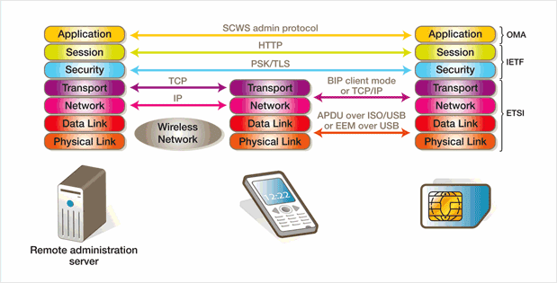
Transfer Layer Security (TLS)
Transfer Layer Security (TLS) is application protocol independent. Successor of SSL
Figure 1: OSI Network Model with TLS layer
Notes:
Figure 1: http://www.gemalto.com/telecom/upteq/images/p8-2.png

Slide 4
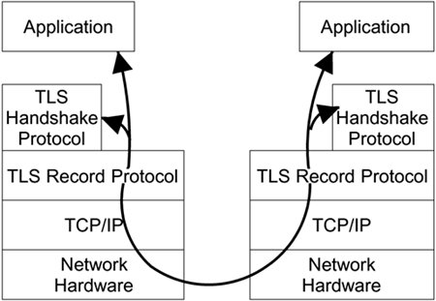
Transfer Layer Security (TLS)
TLS Handshake Protocol
TLS Record Protocol
Figure 2: TLS two layers structure
Notes:
Figure 2: http://etutorials.org/shared/images/tutorials/tutorial_113/09fig01.gif

Slide 5
TLS Handshake Protocol
Responsible for authentication and key exchange necessary to establish or resume secure sessions;
Manages the following:
1. Cipher suite negotiation
2. Authentication of the server and optionally, the client
3. Session key information exchange
Notes:
Ref: TLS Handshake Protocol (Windows), MSDN, http://msdn.microsoft.com/en-us/library/windows/desktop/aa380513(v=vs.85).aspx

Slide 6
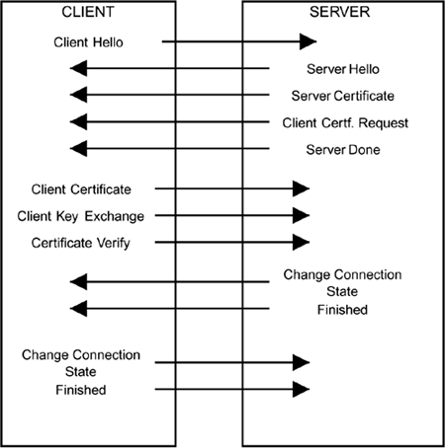
Message Flow for a Full Handshake
Figure 3: TLS Handshake Steps
Notes:
Figure 3: http://etutorials.org/shared/images/tutorials/tutorial_113/09fig03.gif

Slide 7
TLS Record Protocol
Responsible for securing application data using the keys created during the Handshake and verifying its integrity and origin
Manages the following:
1. Dividing outgoing messages and reassembling incoming messages
2. Compressing and decompressing (optional)
3. Applying a Message Authentication Code (MAC) and verifying
4. Encrypting messages and decrypting
Notes:
Ref: TLS Record Protocol (Windows), MSDN, http://msdn.microsoft.com/en-us/library/windows/desktop/aa380514(v=vs.85).aspx

Slide 8
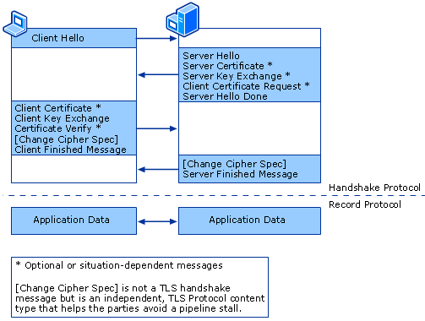
Message Flow for a Full TLS
Figure 4: After handshake Record Layer transfer application data
Notes:
Figure 4: http://technet.microsoft.com/dynimg/IC197609.gif

Slide 9
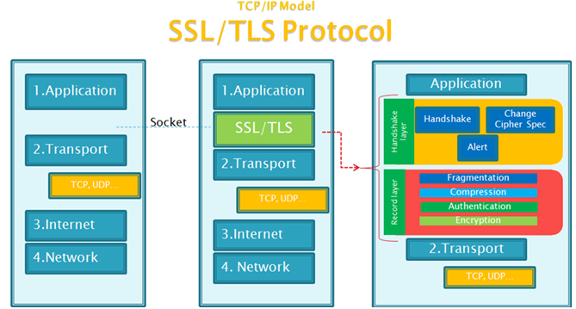
Components of TLS
Figure 5: Detailed components of Transfer Layer Security
Notes:
Figure 5: http://www.vircom.com/security/wp-content/uploads/2012/09/tcp-ip_model_ssl-tls_protocol.png

Slide 10
TLS Ciphersuites
Ciphersuite: Combination of authentication, encryption and message authentication code (MAC) encryption methods, used to negotiate the communication security settings
Ciphersuite Name | Key Exchange | Cipher | Mac
TLS_NULL_WITH_NULL_NULL | NULL | NULL | NULL
TLS_RSA_WITH_NULL_SHA256 | RSA | NULL | SHA256
TLS_DHE_DSS_WITH_AES_256_CBC_SHA256 | DHE_DSS | AES_256_CBC | SHA256
TLS_ECDHE_ECDSA_WITH_AES_128_CCM | ECDHE_ECDSA | AES_128_CCM
TLS_ECDHE_ECDSA_WITH_AES_256_CCM | ECDHE_ECDSA | AES_256_CCM
TLS_ECDHE_ECDSA_WITH_AES_128_CCM_8 | ECDHE_ECDSA | AES_128_CCM_8
TLS_ECDHE_ECDSA_WITH_AES_256_CCM_8 | ECDHE_ECDSA | AES_256_CCM_8
Table 1: Part of TLS ciphersuites, in red are our goals
Notes:
Table 1: http://tools.ietf.org/html/draft-mcgrew-tls-aes-ccm-ecc-02, Section 2
And http://tools.ietf.org/html/rfc5246, Appendix C

Slide 11
Content
Transfer Layer Security (TLS)
Handshake Protocol: ECDHE_ECDSA
Diffe-Hellman Key Exchange Algorithm
Digital Signature Algorithm
Elliptic Curve Cryptography
Elliptic Curve Diffe-Hellman Ephemeral (ECDHE)
Elliptic Curve Digital Signature Algorithm (ECDSA)
Record Protocol: AEAD_AES_CCM

Slide 12
Handshake Protocol: ECDHE_ECDSA
ECDHE_ECDSA: Ephemeral Elliptic Curve Deffe Halman with Elliptic Curve Digital Signature Authentication
Steps
Review Diffe-Hellman Key Exchange Algorithm and Digital Signature Algorithm
Introduce Elliptic Curve Cryptography
Illustrate pseudo-code of ECDHE and ECDSA
Notes:
Ref: http://tools.ietf.org/html/rfc4492, Section 2

Slide 13
Content
Transfer Layer Security (TLS)
Handshake Protocol: ECDHE_ECDSA
Diffe-Hellman Key Exchange Algorithm
Digital Signature Algorithm
Elliptic Curve Cryptography
Elliptic Curve Diffe-Hellman Ephemeral (ECDHE)
Elliptic Curve Digital Signature Algorithm (ECDSA)
Record Protocol: AEAD_AES_CCM

Slide 14
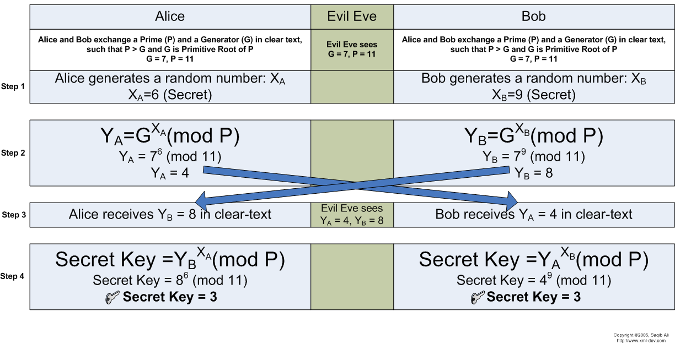
Diffe-Hellman Key Exchange Algorithm
Basic DH based on intractability of discrete logarithm
Figure 6: Steps of discrete logarithm diffie-hellman key exchange
Notes:
Figure 6: http://pds9.egloos.com/pds/200805/29/21/f0037021_483e4ab1896a2.png

Slide 15
Content
Transfer Layer Security (TLS)
Handshake Protocol: ECDHE_ECDSA
Diffe-Hellman Key Exchange Algorithm
Digital Signature Algorithm
Elliptic Curve Cryptography
Elliptic Curve Diffe-Hellman Ephemeral (ECDHE)
Elliptic Curve Digital Signature Algorithm (ECDSA)
Record Protocol: AEAD_AES_CCM

Slide 16
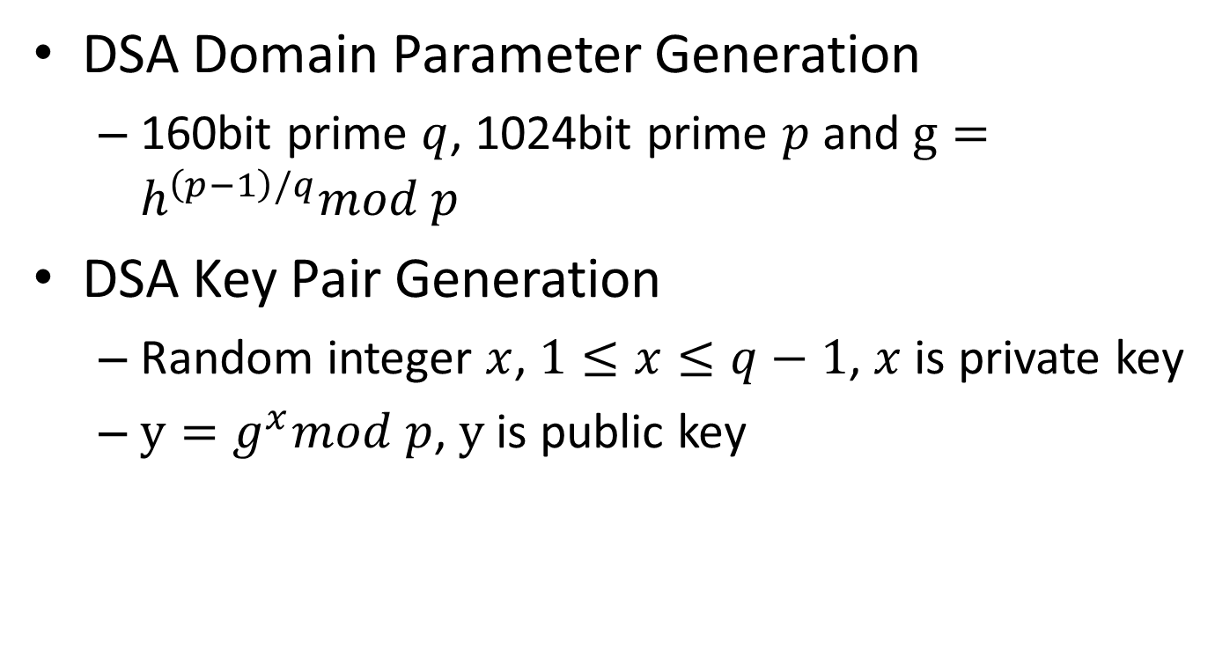
Digital Signature Algorithm
DSA Domain Parameter Generation
160bit prime $q$, 1024bit prime $p$ and $g=h^{\left(p−1\right)/q}mod p$
DSA Key Pair Generation
Random integer $x$, $1≤x≤q−1$, $x$ is private key
$y=g^{x}mod p$, $y$ is public key
Notes:
Ref: The Elliptic Curve Digital Signature Algorithm (ECDSA), Section 2.2, http://cs.ucsb.edu/~koc/ccs130h/notes/ecdsa-cert.pdf

Slide 17
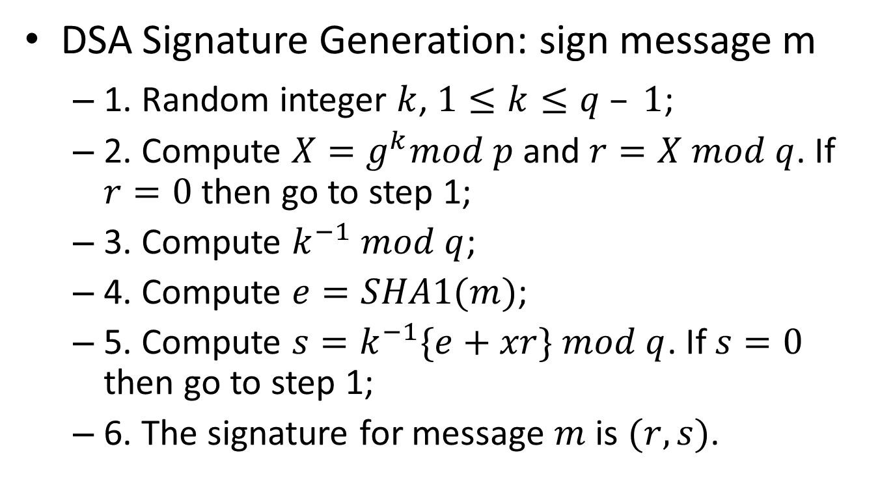
Digital Signature Algorithm
DSA Signature Generation: sign message m
1. Random integer $k$, $1≤k≤q – 1$;
2. Compute $X=g^{k}mod p$and $r=X mod q$. If $r=0$ then go to step 1;
3. Compute $k^{−1} mod q$;
4. Compute $e=SHA1(m)$;
5. Compute $s=k^{−1}\{e+xr\} mod q$. If $s=0$ then go to step 1;
6. The signature for message $m$ is $(r, s)$.
Notes:
Ref: The Elliptic Curve Digital Signature Algorithm (ECDSA), Section 2.2, http://cs.ucsb.edu/~koc/ccs130h/notes/ecdsa-cert.pdf

Slide 18
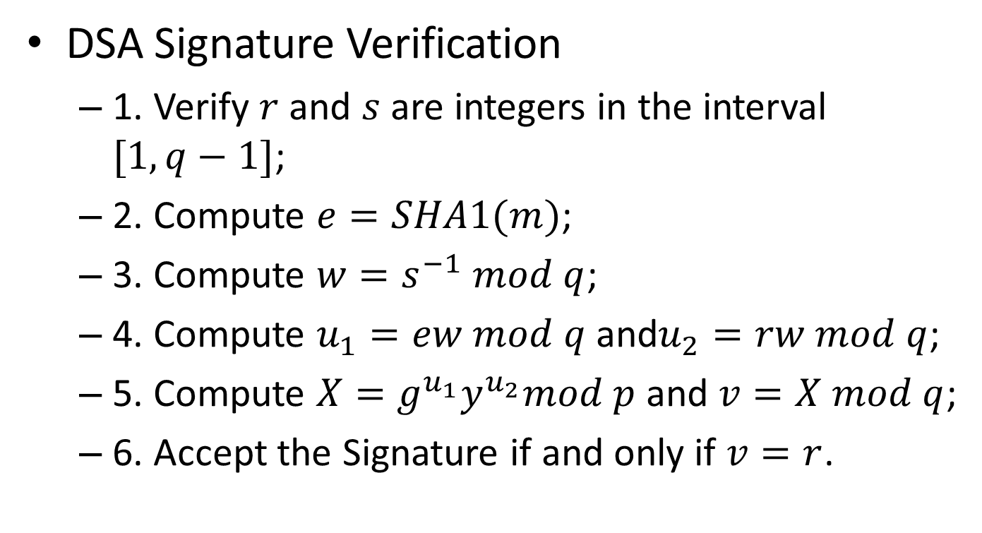
Digital Signature Algorithm
DSA Signature Verification
1. Verify $r$ and $s$ are integers in the interval $[1, q−1]$;
2. Compute $e=SHA1(m)$;
3. Compute $w=s^{−1} mod q$;
4. Compute $u_{1}=ew mod q$and$u_{2}=rw mod q$;
5. Compute $X=g^{u_{1}}y^{u_{2}}mod p$and $v=X mod q$;
6. Accept the Signature if and only if $v=r$.
Notes:
Ref: The Elliptic Curve Digital Signature Algorithm (ECDSA), Section 2.2, http://cs.ucsb.edu/~koc/ccs130h/notes/ecdsa-cert.pdf

Slide 19
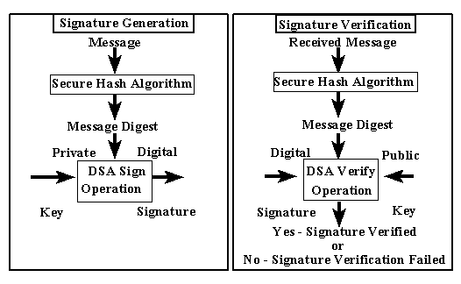
Digital Signature Algorithm
Figure 7: Steps of digital signature algorithm
Notes:
Figure 8: http://www.itl.nist.gov/fipspubs/fip186.gif

Slide 20
Content
Transfer Layer Security (TLS)
Handshake Protocol: ECDHE_ECDSA
Diffe-Hellman Key Exchange Algorithm
Digital Signature Algorithm
Elliptic Curve Cryptography
Elliptic Curve Diffe-Hellman Ephemeral (ECDHE)
Elliptic Curve Digital Signature Algorithm (ECDSA)
Record Protocol: AEAD_AES_CCM

Slide 21
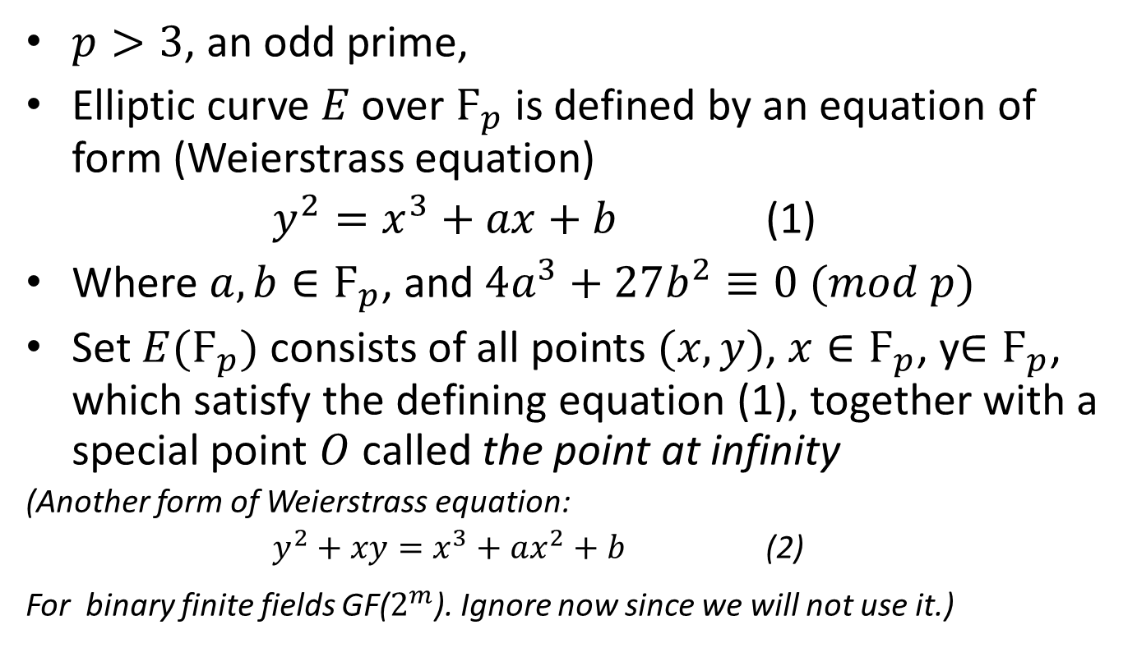
Elliptic Curve Cryptography
$p>3$, an odd prime,
Elliptic curve $E$ over $Ϝ_{p}$ is defined by an equation of form (Weierstrass equation)
$y^{2}=x^{3}+ax+b$ (1)
Where $a, b∈Ϝ_{p}$, and $4a^{3}+27b^{2}≡0 (mod p)$
Set $E(Ϝ_{p})$consists of all points $(x,y)$, $x∈Ϝ_{p}$, y$∈Ϝ_{p}$, which satisfy the defining equation (1), together with a special point $O$ called the point at infinity
(Another form of Weierstrass equation:
$y^{2}+xy=x^{3}+ax^{2}+b$ (2)
For binary finite fields GF($2^{m}$). Ignore now since we will not use it.)
Notes:
Ref: The Elliptic Curve Digital Signature Algorithm (ECDSA), Section 4.1, http://cs.ucsb.edu/~koc/ccs130h/notes/ecdsa-cert.pdf

Slide 22
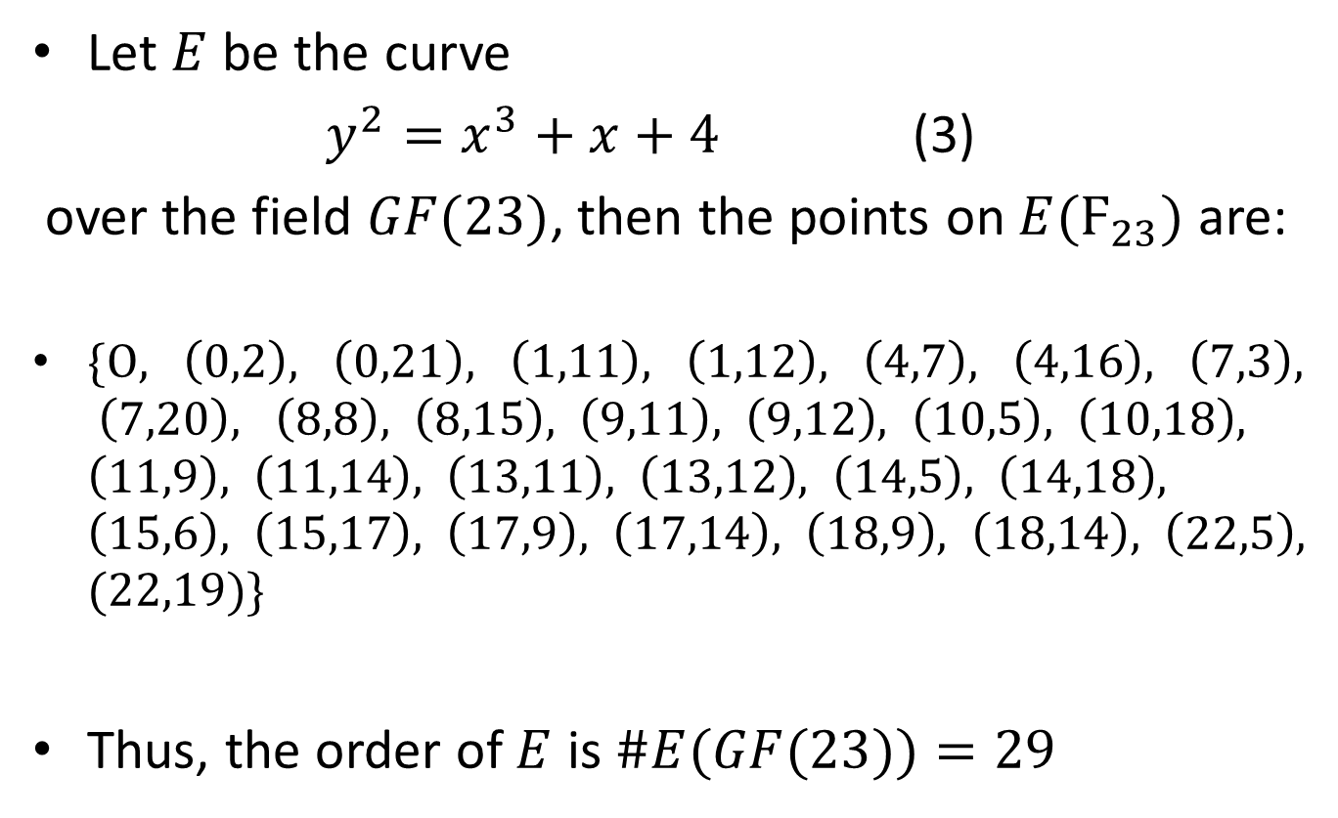
Elliptic Curve: Example
Let $E$ be the curve
$y^{2}=x^{3}+x+4$ (3)
over the field $GF(23)$, then the points on $E(Ϝ_{23})$ are:
$\{Ο, \left(0,2\right), \left(0,21\right), \left(1,11\right), \left(1,12\right), \left(4,7\right), \left(4,16\right), \left(7,3\right), \left(7,20\right), \left(8,8\right), \left(8,15\right), \left(9,11\right), \left(9,12\right), \left(10,5\right), \left(10,18\right), \left(11,9\right), \left(11,14\right), \left(13,11\right), \left(13,12\right), \left(14,5\right), \left(14,18\right), \left(15,6\right), \left(15,17\right), \left(17,9\right), \left(17,14\right), \left(18,9\right), \left(18,14\right), \left(22,5\right), (22,19)\}$
Thus, the order of $E$ is $\#E(GF(23))=29$
Notes:
Ref: IEEE Standard Specifications for Public-Key Cryptography, Section A.9.1, http://ieeexplore.ieee.org/stamp/stamp.jsp?tp=&arnumber=891000

Slide 23
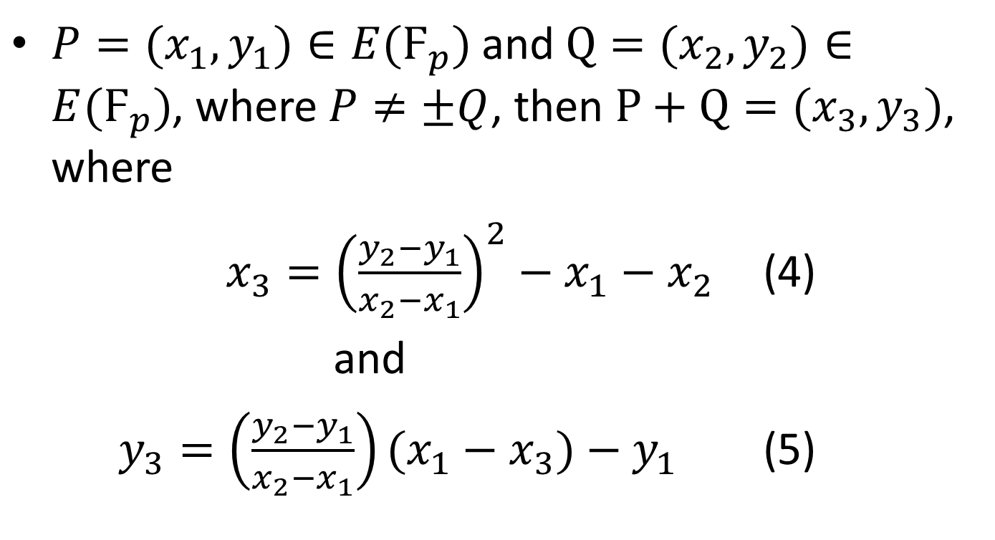
EC Operations: Point Addition
$P=(x_{1},y_{1})∈E(Ϝ_{p})$and $Q=(x_{2},y_{2})∈E(Ϝ_{p})$, where $P≠±Q$, then $P+Q=(x_{3},y_{3})$, where
$x_{3}={\left(\frac{y_{2}−y_{1}}{x_{2}−x_{1}}\right)}^{2}−x_{1}−x_{2}$ (4)
and
$y_{3}=\left(\frac{y_{2}−y_{1}}{x_{2}−x_{1}}\right)(x_{1}−x_{3})−y_{1}$ (5)

Slide 24
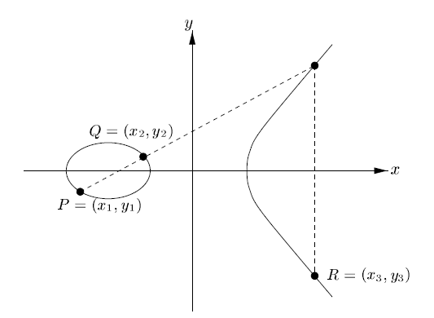
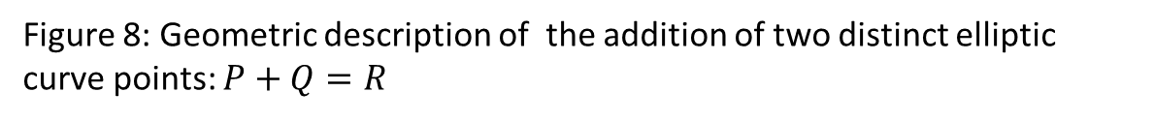
EC Operations: Point Addition
Figure 8: Geometric description of the addition of two distinct elliptic curve points: $P+Q=R$
Notes:
Ref: The Elliptic Curve Digital Signature Algorithm (ECDSA), Section 4.1, http://cs.ucsb.edu/~koc/ccs130h/notes/ecdsa-cert.pdf

Slide 25
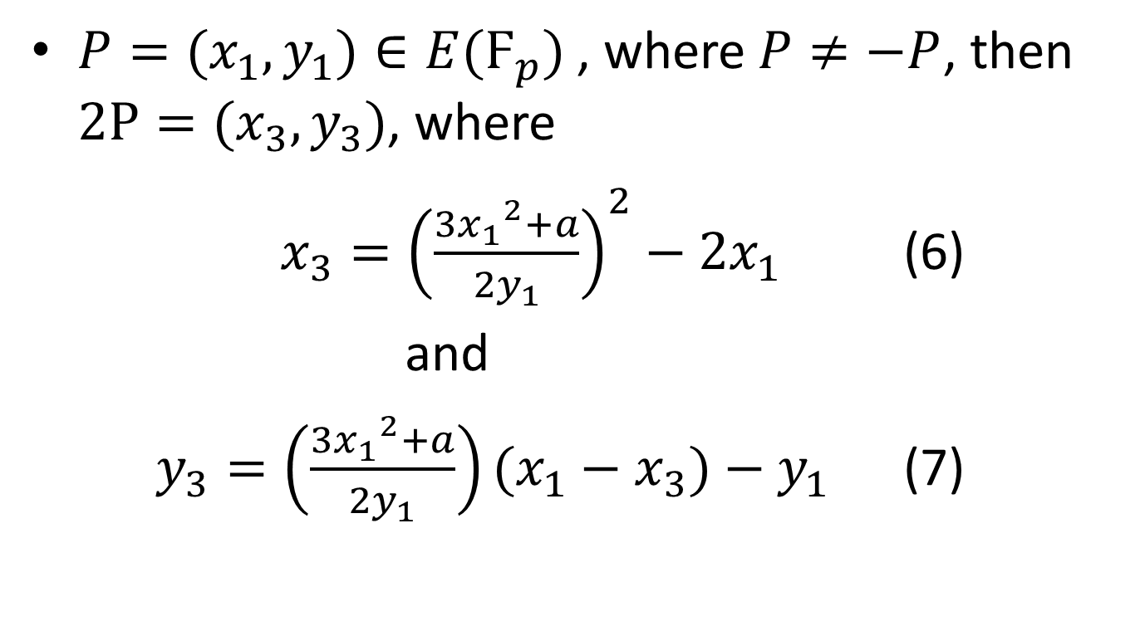
EC Operations: Point Doubling
$P=(x_{1},y_{1})∈E(Ϝ_{p})$, where $P≠−P$, then $2P=(x_{3},y_{3})$, where
$x_{3}={\left(\frac{{{3x}_{1}}^{2}+a}{{2y}_{1}}\right)}^{2}−{2x}_{1}$ (6)
and
$y_{3}=\left(\frac{{{3x}_{1}}^{2}+a}{{2y}_{1}}\right)(x_{1}−x_{3})−y_{1}$ (7)

Slide 26
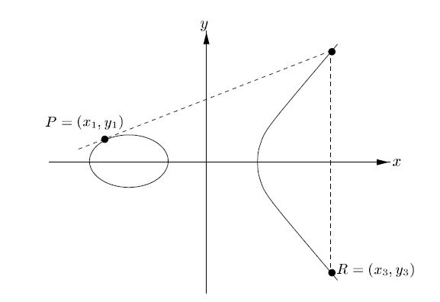
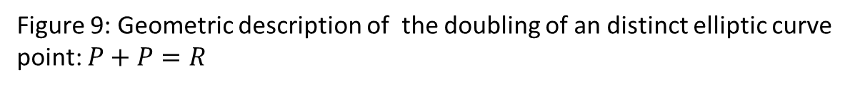
EC Operations: Point Doubling
Figure 9: Geometric description of the doubling of an distinct elliptic curve point: $P+P=R$
Notes:
Ref: The Elliptic Curve Digital Signature Algorithm (ECDSA), Section 4.1, http://cs.ucsb.edu/~koc/ccs130h/notes/ecdsa-cert.pdf

Slide 27
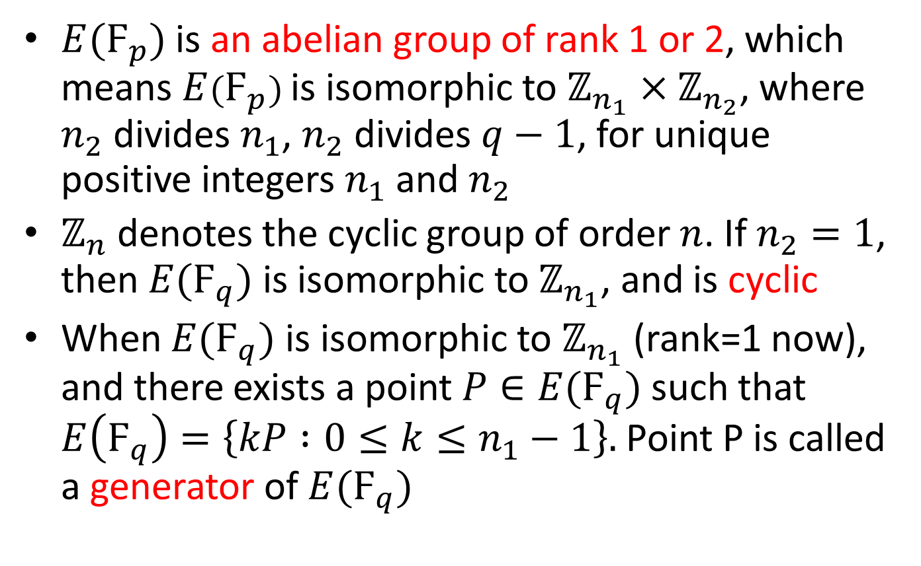
Property of Elliptic Curve
$E(Ϝ_{p})$ is an abelian group of rank 1 or 2, which means$E(Ϝ_{p})$ is isomorphic to $ℤ_{n_{1}}×ℤ_{n_{2}}$, where $n_{2}$ divides $n_{1}$, $n_{2}$ divides $q−1$, for unique positive integers $n_{1}$ and $n_{2}$
$ℤ_{n}$ denotes the cyclic group of order $n$. If $n_{2}=1$, then $E(Ϝ_{q})$ is isomorphic to $ℤ_{n_{1}}$, and is cyclic
When $E(Ϝ_{q})$ is isomorphic to $ℤ_{n_{1}}$ (rank=1 now), and there exists a point $P∈E(Ϝ_{q})$such that $E\left(Ϝ_{q}\right)=\left\{kP :0≤k≤n_{1}−1\right\}.$Point P is called a generator of $E(Ϝ_{q})$
Notes:
Ref: The Elliptic Curve Digital Signature Algorithm (ECDSA), Section 4.3, http://cs.ucsb.edu/~koc/ccs130h/notes/ecdsa-cert.pdf

Slide 28
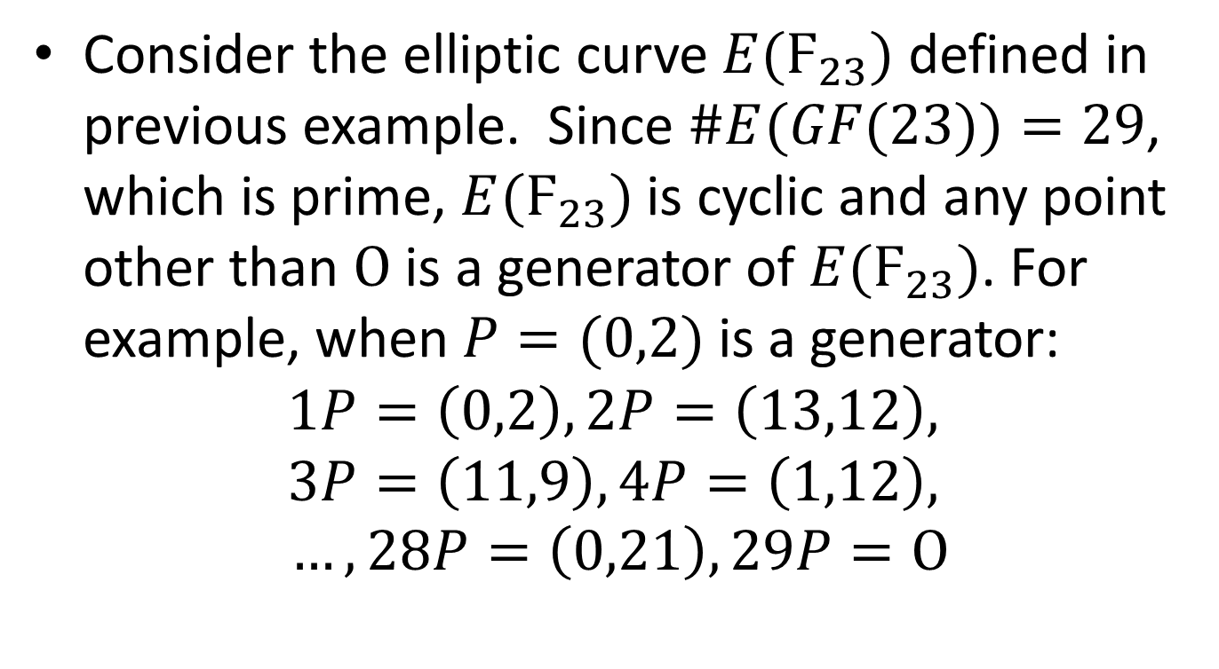
Cyclic Elliptic Curve: Example
Consider the elliptic curve $E(Ϝ_{23})$ defined in previous example. Since $\#E(GF(23))=29$, which is prime, $E(Ϝ_{23})$ is cyclic and any point other than $Ο$ is a generator of $E(Ϝ_{23})$. For example, when $P=(0,2)$ is a generator:
$$1P=\left(0,2\right), 2P=\left(13,12\right),$$
$$3P=\left(11,9\right), 4P=\left(1,12\right),$$
$$…, 28P=\left(0,21\right), 29P=Ο$$
Notes:
Ref: The Elliptic Curve Digital Signature Algorithm (ECDSA), Section 4.3, http://cs.ucsb.edu/~koc/ccs130h/notes/ecdsa-cert.pdf

Slide 29
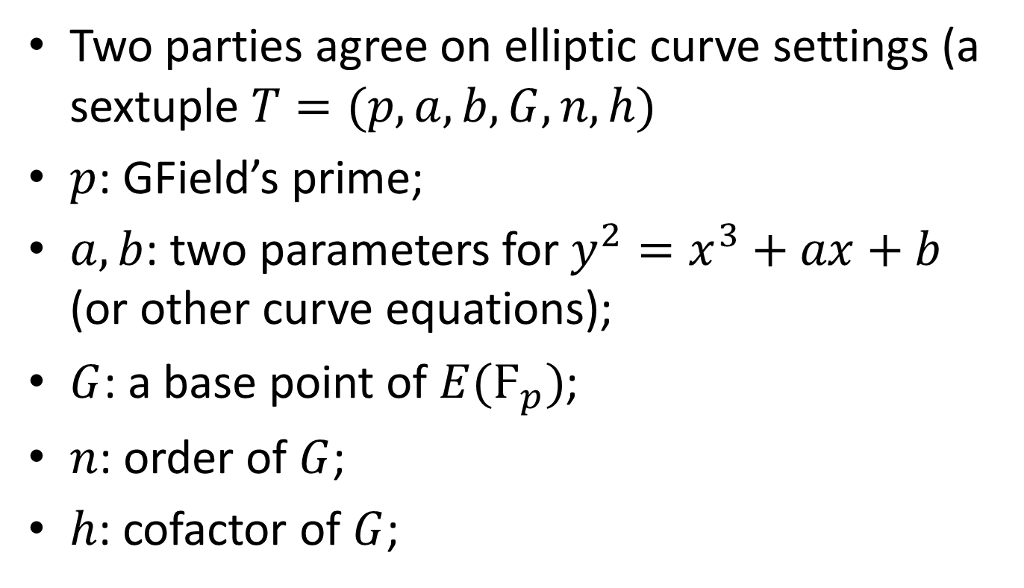
How to replace Discrete Logarithm with Elliptic Curve
Two parties agree on elliptic curve settings (a sextuple $T=(p,a,b,G,n,h)$
$p$: GField’s prime;
$a, b$: two parameters for $y^{2}=x^{3}+ax+b$ (or other curve equations);
$G$: a base point of $E(Ϝ_{p})$;
$n$: order of $G$;
$h$: cofactor of $G$;
Notes:
Ref: SEC 2: Recommended Elliptic Curve Domain Parameters, Section 2.1, http://www.secg.org/collateral/sec2_final.pdf,

Slide 30
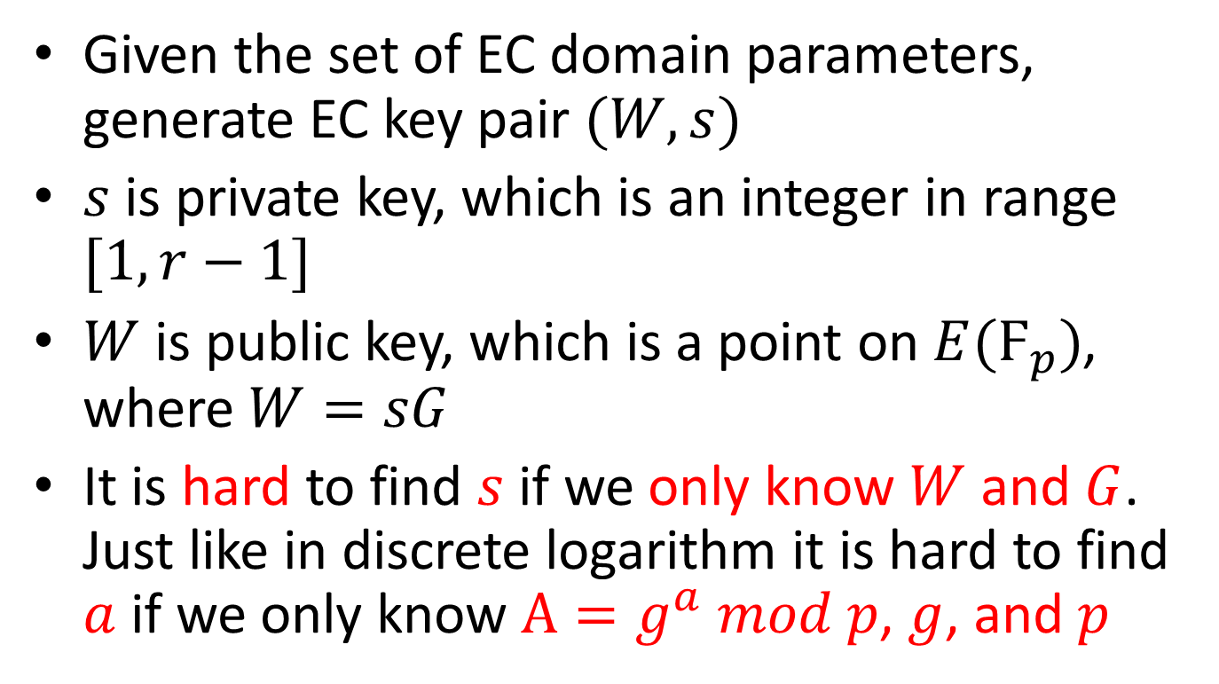
How to replace Discrete Logarithm with Elliptic Curve
Given the set of EC domain parameters, generate EC key pair $(W, s)$
$s$ is private key, which is an integer in range $[1, r−1]$
$W$ is public key, which is a point on $E(Ϝ_{p})$, where $W=sG$
It is hard to find $s$ if we only know $W$ and $G$. Just like in discrete logarithm it is hard to find $a$ if we only know $A=g^{a} mod p$, $g$, and $p$

Slide 31
Advantage of ECC: smaller key sizes
Using more complex math to shorten the key sizes, while complex math does not mean adding time complexity in algorithm
Symmetric | ECC | DH/DSA/RSA
80 | 163 | 1024
112 | 233 | 2048
128 | 283 | 3072
192 | 409 | 7680
256 | 571 | 15360
Table 2: Comparable Key Sizes (in bit)
Notes:
Ref: http://tools.ietf.org/html/rfc4492, Section 1
Smaller key sizes result in savings for power, memory, bandwidth, and computational cost that make ECC especially attractive for constrained environments.

Slide 32
Content
Transfer Layer Security (TLS)
Handshake Protocol: ECDHE_ECDSA
Diffe-Hellman Key Exchange Algorithm
Digital Signature Algorithm
Elliptic Curve Cryptography
Elliptic Curve Diffe-Hellman Ephemeral (ECDHE)
Elliptic Curve Digital Signature Algorithm (ECDSA)
Record Protocol: AEAD_AES_CCM

Slide 33
Elliptic Curve Diffe-Hellman Ephemeral (ECDHE)
Using ECKAS-DH1 scheme with the identity map as key derivation function (KDF)

Slide 34
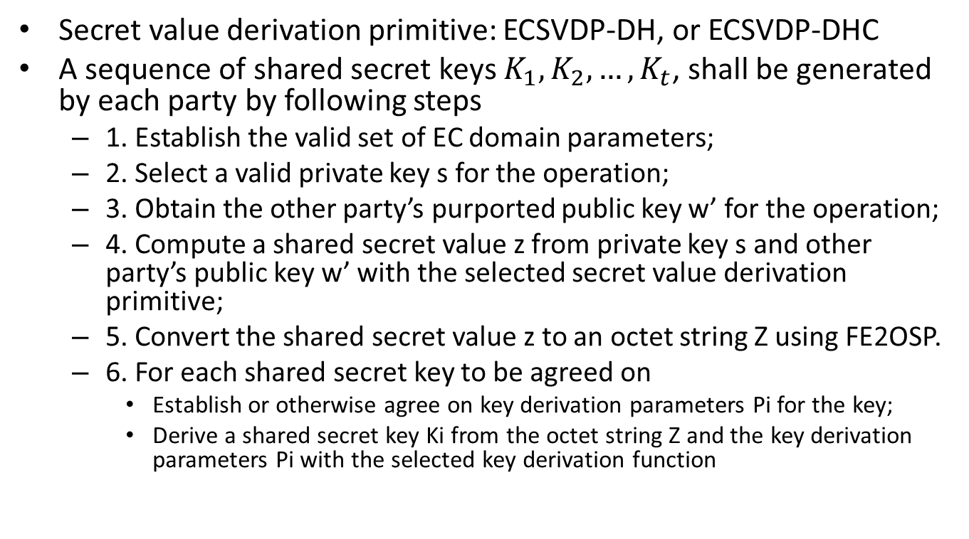
ECKAS-DH1: Elliptic Curve Key Agreement Scheme, Diffie-Hellman version
Secret value derivation primitive: ECSVDP-DH, or ECSVDP-DHC
A sequence of shared secret keys $K_{1},K_{2}, …,K_{t}$, shall be generated by each party by following steps
1. Establish the valid set of EC domain parameters;
2. Select a valid private key s for the operation;
3. Obtain the other party’s purported public key w’ for the operation;
4. Compute a shared secret value z from private key s and other party’s public key w’ with the selected secret value derivation primitive;
5. Convert the shared secret value z to an octet string Z using FE2OSP.
6. For each shared secret key to be agreed on
Establish or otherwise agree on key derivation parameters Pi for the key;
Derive a shared secret key Ki from the octet string Z and the key derivation parameters Pi with the selected key derivation function

Slide 35
Content
Transfer Layer Security (TLS)
Handshake Protocol: ECDHE_ECDSA
Diffe-Hellman Key Exchange Algorithm
Digital Signature Algorithm
Elliptic Curve Cryptography
Elliptic Curve Diffe-Hellman Ephemeral (ECDHE)
Elliptic Curve Digital Signature Algorithm (ECDSA)
Record Protocol: AEAD_AES_CCM

Slide 36
Elliptic Curve Digital Signature Algorithm (ECDSA)
Elliptic Curve Digital Signature Algorithm (ECDSA)

Slide 37
Content
Transfer Layer Security (TLS)
Handshake Protocol: ECDHE_ECDSA
Record Protocol: AEAD_AES_CCM
AEAD: Authenticated encryption with associated data
AES: Advanced encryption standard
CCM: Counter with Cipher Block Chaining – Message Authentication Code

Slide 38
Authenticated Encryption with Associated Data (AEAD)
Many cryptographic applications require both confidentiality and message authentication
Confidentiality: data is available only to those authorized to obtain it, usually realized through encryption;
Message authentication: data has not been altered or forged by unauthorized entities;
AEAD algorithm will provide both by using a single cryptoalgorithm
Notes:
Ref: http://tools.ietf.org/html/rfc5116, Section 1.1

Slide 39
Content
Transfer Layer Security (TLS)
Handshake Protocol: ECDHE_ECDSA
Record Protocol: AEAD_AES_CCM
AEAD: Authenticated Encryption with Associated Data
AES: Advanced Encryption Standard
CCM: Counter with Cipher Block Chaining – Message Authentication Code

Slide 40
Advanced Encryption Standard (AES)
Originally called Rijndael algorithm;
Notes:
Ref: AES Proposal: Rijndael, http://csrc.nist.gov/archive/aes/rijndael/Rijndael-ammended.pdf

Slide 41
Content
Transfer Layer Security (TLS)
Handshake Protocol: ECDHE_ECDSA
Record Protocol: AEAD_AES_CCM
AEAD: Authenticated Encryption with Associated Data
AES: Advanced Encryption Standard
CCM: Counter with Cipher Block Chaining – Message Authentication Code

Slide 42
CCM: Counter with Cipher Block Chaining – Message Authentication Code
Generation-encryption process:
Prerequisites:
block cipher algorithm;
key K;
counter generation function;
formatting function;
MAC length Tlen.
Input:
valid nonce N;
valid payload P of length Plen bits;
valid associated data A;
Output:
ciphertext C.
Notes:
Ref, The CCM Mode for
Authentication and Confidentiality, Section 6.1, http://csrc.nist.gov/publications/nistpubs/800-38C/SP800-38C_updated-July20_2007.pdf

Slide 43
CCM: Counter with Cipher Block Chaining – Message Authentication Code
Generation-encryption process:
Steps:
1. Apply the formatting function to (N, A, P) to produce the blocks B0, B1, …, Br.
2. Set Y0= CIPHK(B0).
3. For i = 1 to r, do Yi = CIPHK(Bi ⊕ Yi-1).
4. Set T=MSBTlen(Yr).
5. Apply the counter generation function to generate the counter blocks Ctr0, Ctr1, …, Ctrm, where ⎡⎤128Plenm=.
6. For j=0 to m, do Sj= CIPHK(Ctrj).
7. Set S= S1 || S2 || …|| Sm.
8. Return C=(P ⊕ MSBPlen(S)) || (T ⊕ MSBTlen(S0)).
Notes:
Ref, The CCM Mode for
Authentication and Confidentiality, Section 6.1, http://csrc.nist.gov/publications/nistpubs/800-38C/SP800-38C_updated-July20_2007.pdf

Slide 44
CCM: Counter with Cipher Block Chaining – Message Authentication Code
Decryption-verification process:
Prerequisites:
block cipher algorithm;
key K;
counter generation function;
formatting function;
valid MAC length Tlen.
Input:
nonce N;
associated data A;
purported ciphertext C of length Clen bits;
Output:
either the payload P or INVALID.
Notes:
Ref, The CCM Mode for
Authentication and Confidentiality, Section 6.2, http://csrc.nist.gov/publications/nistpubs/800-38C/SP800-38C_updated-July20_2007.pdf

Slide 45
CCM: Counter with Cipher Block Chaining – Message Authentication Code
Generation-encryption process:
Steps:
1. If Clen≤Tlen, then return INVALID.
2. Apply the counter generation function to generate the counter blocks Ctr0, Ctr1, …, Ctrm, where ⎡⎤128)(TlenClenm−=.
3. For j=0 to m, do Sj= CIPHK(Ctrj).
4. Set S= S1 || S2 || …|| Sm.
5. Set P=MSBClen-Tlen(C) ⊕ MSBClen-Tlen(S).
6. Set T=LSBTlen(C) ⊕ MSBTlen(S0).
7. If N, A, or P is not valid, as discussed in Section 5.4, then return INVALID, else apply the formatting function to (N, A, P) to produce the blocks B0, B1, …, Br.
8. Set Y0= CIPHK(B0).
9. For i = 1 to r, do Yj = CIPHK(Bi ⊕ Yi-1).
10. If T≠MSBTlen(Yr), then return INVALID, else return P.
Notes:
Ref, The CCM Mode for
Authentication and Confidentiality, Section 6.2, http://csrc.nist.gov/publications/nistpubs/800-38C/SP800-38C_updated-July20_2007.pdf

Slide 46
Implementation
Set up TCP/IP Link
AES Component
Record Layer: AEAD_AES_128_CCM
ECDHE Component
ECDSA Component
Handshake Layer: ECDHE_ECDSA
Test
To Do List

Slide 47
Set up TCP/IP Link
Using Windows Sockets API (Winsock)
Basic client and server code from MSDN
http://msdn.microsoft.com/en-us/library/windows/desktop/ms737591(v=vs.85).aspx
http://msdn.microsoft.com/en-us/library/windows/desktop/ms737593(v=vs.85).aspx

Slide 48
Structure of Client
Initialize socket;
Clientphase = InitialC (or TestC);
While(){
clientphase:
TestC: test the socket api
InitialC: initialize all parameters
HandshakeRelatedC: do handshake
RecordPrepareC: generate keys with master secret
RecordLayerC: transfer the data and verify the received data
ExitC: exit the while loop
}
Close the socket;

Slide 49
Structure of Server
Initialize socket;
Serverphase = InitialS (or TestS);
While(){
serverphase:
TestS: test the socket api
InitialS: initialize all parameters
HandshakeRelatedS: do handshake
RecordPrepareS: generate keys with master secret
RecordLayerS: transfer the data and verify the received data
ExitS: exit the while loop
}
Close the socket;

Slide 50
Implementation
Set up TCP/IP Link
AES Component
Record Layer: AEAD_AES_128_CCM
ECDHE Component
ECDSA Component
Handshake Layer: ECDHE_ECDSA
Test
To Do List

Slide 51
AES Component
From this link: http://code.google.com/p/lostinactionscript/downloads/detail?name=AES.zip&can=2&q=

Slide 52
Implementation
Set up TCP/IP Link
AES Component
Record Layer: AEAD_AES_128_CCM
ECDHE Component
ECDSA Component
Handshake Layer: ECDHE_ECDSA
Test
To Do List

Slide 53
Record Layer: AEAD_AES_128_CCM
Implemented according many references.

Slide 54
Implementation
Set up TCP/IP Link
AES Component
Record Layer: AEAD_AES_128_CCM
ECDHE Component
ECDSA Component
Handshake Layer: ECDHE_ECDSA
Test
To Do List

Slide 55
Test
Did a complete single package test.
Since we only have record layer, server will set the security parameters and send to client. Then both of them use these parameters to generate the keys.

Slide 56
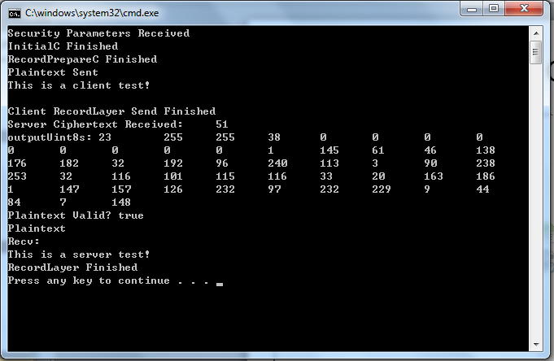
Test: Client Output

Slide 57
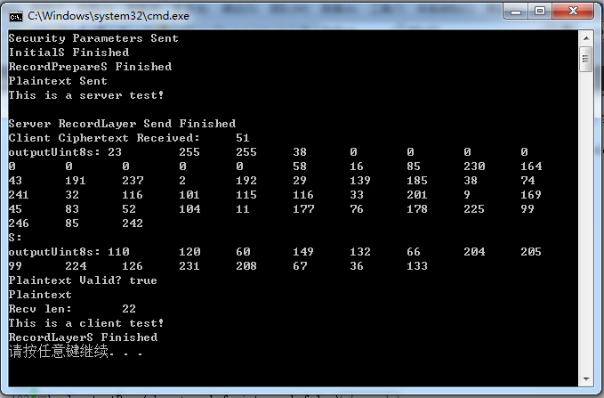
Test: Server Output

Slide 58
To Do List
Optimize the current code. There are a lot of questions that need to be solved. I have kept them in a google doc;
Expand the code to normal data transfer requirement. For example, transfer a big html page, or provide an API for http service;
Finish the handshake protocol.

Slide 59
Thank you!

